Slide 1

The lecture will start soon at 08:30
https://unsplash.com/photos/gm3bxHin8VA
Notes:
https://unsplash.com/photos/gm3bxHin8VA

Slide 2
MySQL for Data Analytics
Lecturer: Yong Liu
Contact me at: Yong.liu@aalto.fi

Slide 3
Big assignment is available now
Deadline: November 12, 2022. You have one month time to work on the assignment after the last lecture of the course.
Please do not share your code or copy others' code. Cheating (such as copying) on assignments will lead to course failure.
Evaluation scheme is available at slides of the first lecture.

Slide 4
Hands-on session as a service
https://aalto.zoom.us/j/9447227480
One additional & optional hands-on session on September 14
Zoom: https://aalto.zoom.us/j/5138969960
Time: 14:00 and 15:30

Slide 5
Tips
MySQL command is NOT case-sensitive.
The names of database, table, columns are not case-sensitive in Windows, but case-sensitive in most varieties of Unix.

Slide 6
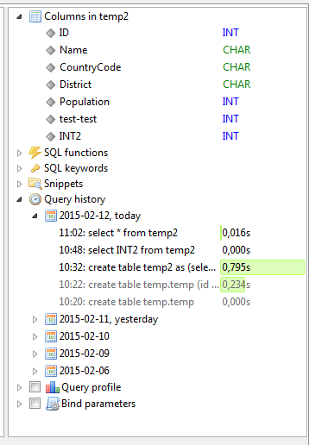
Tips for HeidiSQL (1)
HeidiSQL provides “Query history”.
Remember to use this function!

Slide 7
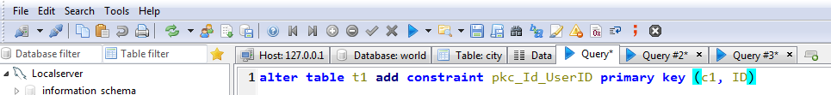
Tips for HeidiSQL(2)
In HeidiSQL, you can have several query-windows!

Slide 8
Content
- Difference between remote and local server
- Exporting data to be a .csv file (Tips)
Writing comments (annotations) for a query
Create, drop and change (default) database
Create and drop table in a database
Understanding data types

Slide 9
Section 1
Remote server | Local server
Main workstation—a supercomputer (Hostname : Johnson.org.aalto.fi) Your data is normally hosted and operated by a supercomputer The speed of data manipulation could be very fast | Main workstation—your own laptop (Hostname: 127.0.0.1) Your data is hosted and operated locally. The speed of data manipulation is determined by the capability of your own laptop
Network is required! Can only be used in student network in our case | Network is not necessary! Can be used everywhere with your own laptop
Permission Often restricted user right E.g., cannot create database | Permission Full user right
Security of data Your data is secure even if your own computer collapses. | Security of data You may lose your data if your system collapses.

Slide 10
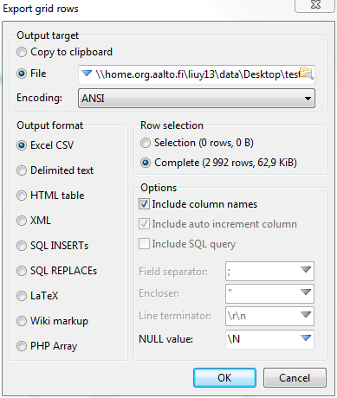

Section 2: export data to be a csv file
Select the table that you want to export.
Activate the data windows
Tool→ export grid rows

Slide 11
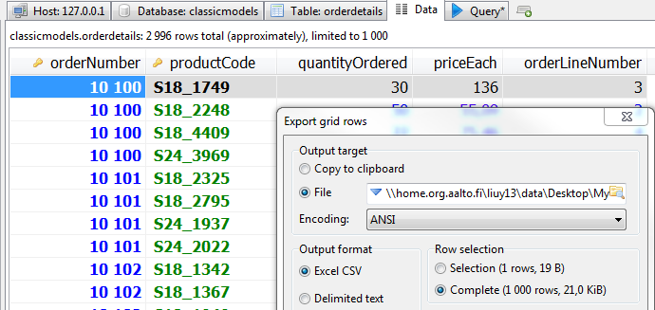
HeidiSQL Tips (1): showing more records

Slide 12
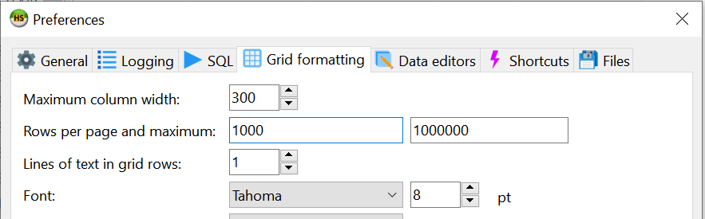

HeidiSQL Tips (2): showing more records
Solution 1:
Tools→ Preferences→ Grid formatting
Solution 2:
Fast key: ctrl + End

Slide 13
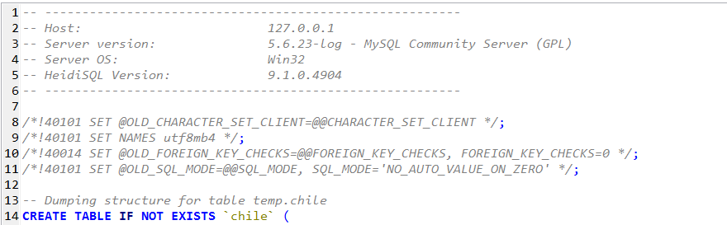
Section 3: Adding comments
Notes:
# hashtag
Minus
/ slash

Slide 14
Adding comments: methods
“#” [hashtag] character to the end of the line.
“-- ” sequence to the end of the line. Must be followed by at least one whitespace or control character (such as a space, tab, newline, and so on).
/* sequence to the following */ sequence. Extend a comment to over multiple lines
Notes:
#: hashtag
-: dash/hyphen.
/ slash

Slide 15
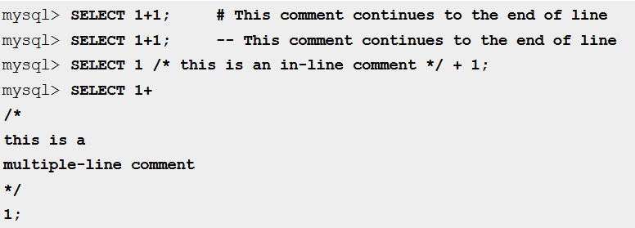
Examples of adding comments
A semicolon ends a command.
However, in HeidiSQL, if you run only one command, you don’t have to
type semicolon.
Notes:
# hashtag
Minus
/ slash

Slide 16
Section 4: Managing database
Table 1
Table 1
Table 1
Table 2
Table 2
Table 2
Table 3
Table 3
Table 3
…
…
…
Database 1
Database 2
Database 3
.…..
User account

Slide 17
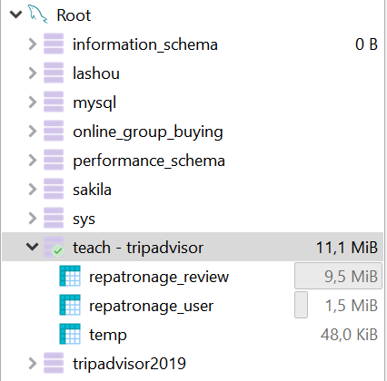
Tips
Typically, you should use the same database to host all relevant data (tables) belonging to the same research project.
Don’t distribute your tables that belong to the same research project across different databases.
Click to activate a database before operating any command on tables belonging to that database.
Different databases

Slide 18
Only with Root account – full admin rights
Creating a database
Create database `for_example`
Removing a database
Drop database `for_example`
Change default database
use `for_example`
All these operations can be done via clicking on HeidiSQL’s interface.

Slide 19
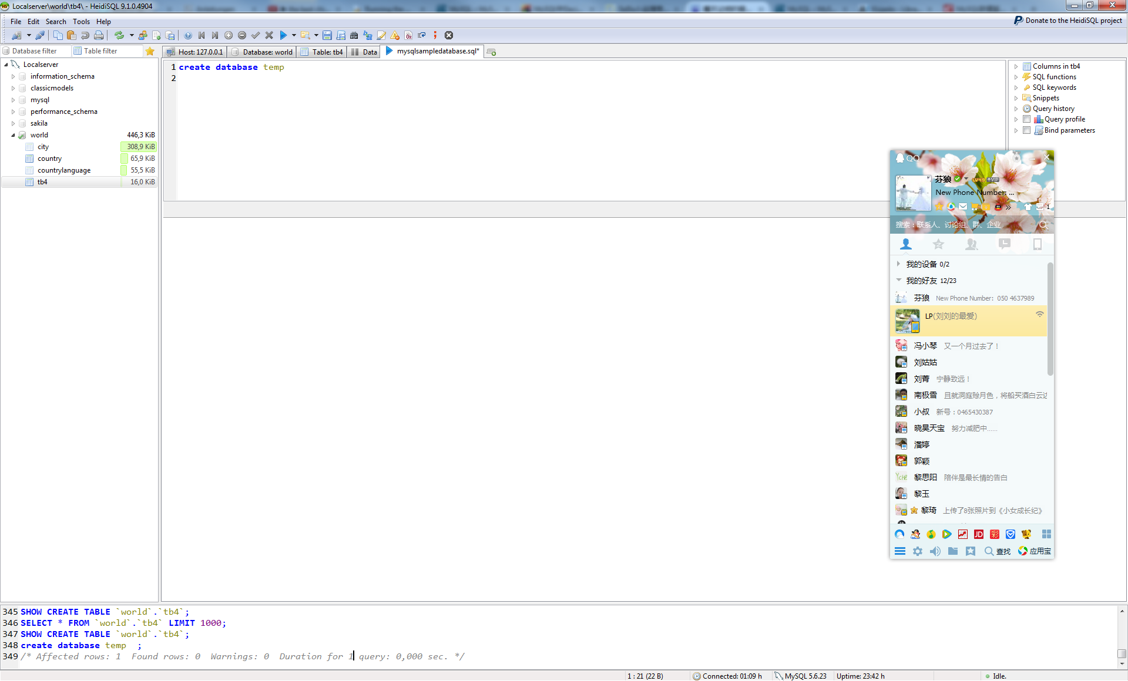
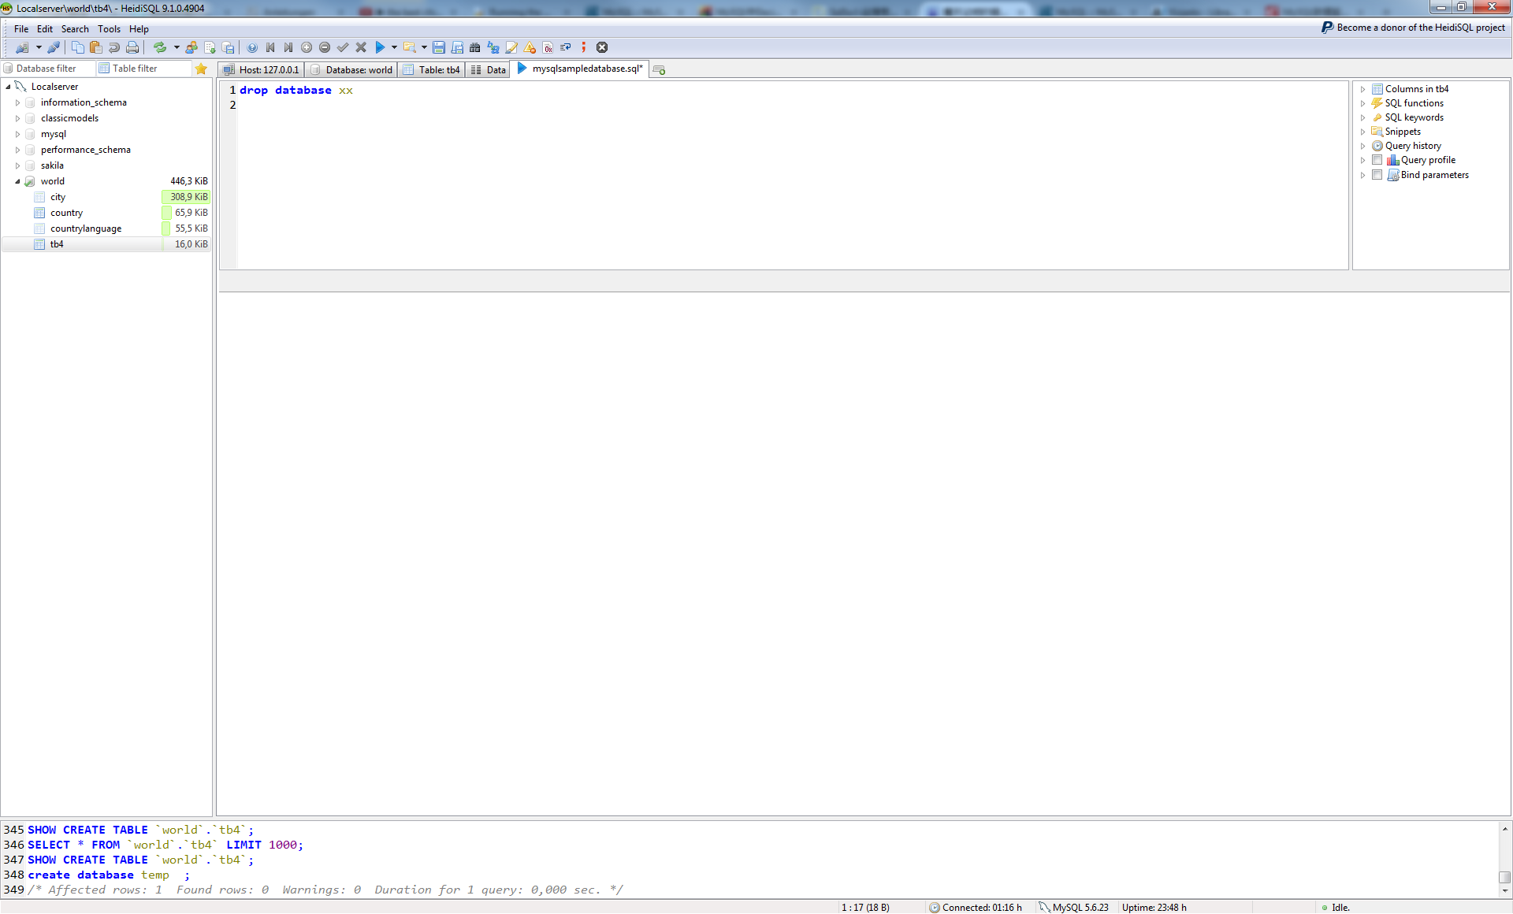
Statistics of running MySQL commands
Command to create a database named as ‘temp’
No error message: command OK

Slide 20
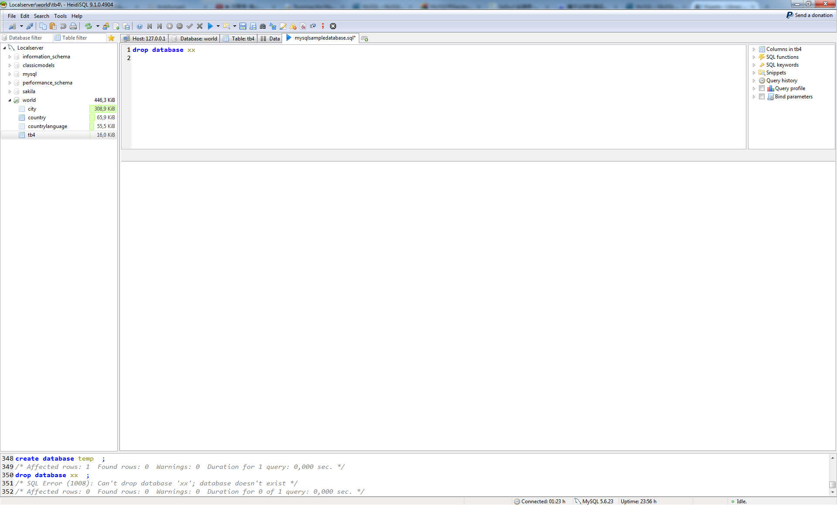
Report: identifying error
What is the error?
Tips: Always briefly browse ‘report’ after running a command

Slide 21
Section 5: Create a table
You can create a table via clicking the buttons of HeidiSQL.
Alternatively, you could use commands: E.g.
create table TableName (Variable1 datatype [constraint],
Variable2 datatype [constraint],
Variable3 datatype [constraint],
……
);
Required field

Slide 22
Example
We will talk about “primary key” later.
create table tb4 (
id int(10) primary key,
name varchar(20)
);
create table TableName ( Variable1 datatype [constraint],
Variable2 datatype [constraint],
Variable3 datatype [constraint],
……
);
New MySQL vocabulary: “create”, “table”, “int”, “varchar”, “primary key”

Slide 23
Drop table
Which one do you think is the correct command to remove a table?
a) Remove table tableName;
b) Delete table tableName;
c) Drop table tableName;
d) Drop tableName;
This one does not work!
Please use Presemo to provide your answer at: presemo.aalto.fi/drm

Slide 24
Drop table
Command to drop a table
drop table TableName;
If you want drop multiple tables in one command
drop table TableName1, TableName2, TableName3;
Use comma in a command to describe ‘equal’ subjects.

Slide 25
Restrictions on table and column names
The names cannot exceed 18 characters.
The names must start with a letter.
The names can contain letters, numbers, and underscores(_)
The names cannot contain spaces.

Slide 26
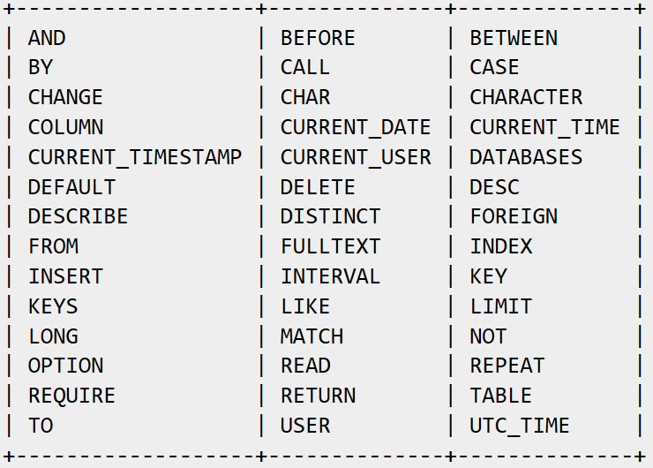
Tips: Don’t use reserved words as table or column name
See the full list of reserved words at: http://dev.mysql.com/doc/mysqld-version-reference/en/mysqld-version-reference-reservedwords-5-7.html

Slide 27
Tips
‘Date’ and ‘Year’ are often used in different data files as variables names, but they are reserved words in MySQL.
Handling reserved words by HeidiSQL.

Slide 28
Section 6: Data types
Consistency
Validation
Compactness
Performance
create table TableName (Variable1 datatype [constraint],
Variable2 datatype [constraint],
Variable3 datatype [constraint],
……
);
Notes:
While creating table, for each column, you specify a data type, i.e. what kind of data you want to store.
This enables several benefits :
Consistency : A column can store a single type of value. So, when you select a column with integer type, you are sure that the rest will be integer only.
Validation : A column cannot store different types of values. So, if a column's type is integer, you can not store string there.
Compactness: Since a column can store a single type of value, it is stored in a compact way.
Performance: Since type is uniform in a column, the values stored can be processed quickly, which enhances performance

Slide 29
MySQL data types
Numeric Types
Date and Time Types
String Types
Spatial Data Types (Not covered in the course)

Slide 30
Numeric types
Integer types (Exact value)
E.g. Int
Fix-point types (Exact value)
Decimal
Floating-point (Approximate value)
E.g. Float

Slide 31
Unsigned vs. signed
Create Table xx (
variable1 INT UNSIGNED,
variable2 INT);
New MySQL vocabulary: “signed”, “unsignd”.

Slide 32
Numeric types: Integer Types
Type | Storage (Bytes) | Value range (Unsigned) | Value range (Signed)
TINYINT | 1 | 0～255 | -128～127
SMALLINT | 2 | 0～65,535 | -32,768～32,767
MEDIUMINT | 3 | 0～16,777,215 | -8,388,608～8,388,607
INT | 4 | 0～4,294,967,295 | -2,147,483,648～2,147,483,647
BIGINT | 8 | 0～18446744073709551615 | -9223372036854775808～9223372036854775807
‘Signed’ is a default setting.
Notes:
default [SIGNED]

Slide 33
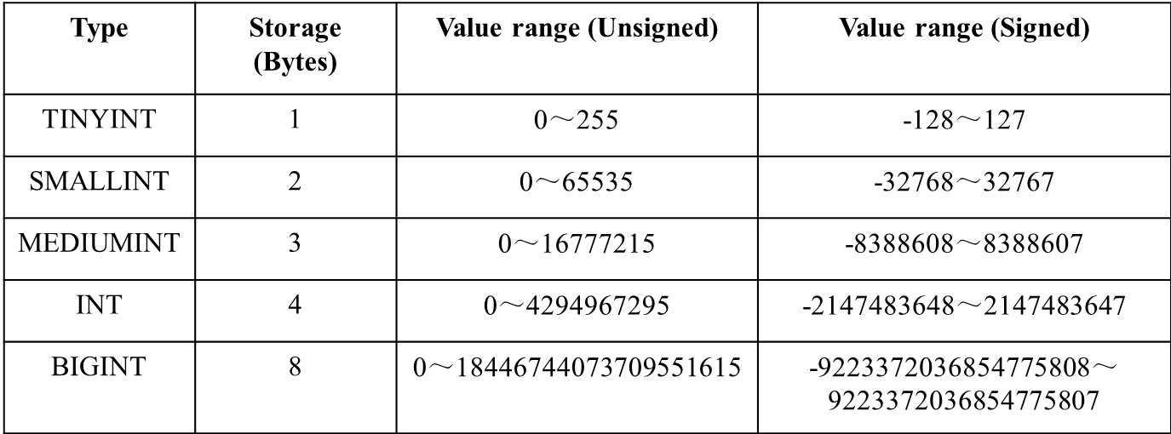
Questions (1)
Which numeric type is good for a variable representing the number of dates in a month (e.g., the number of working days), or the number of the dates of a year?
TinyINT for the dates of a month
SmallINT for the dates of a year

Slide 34
Questions (2)
Do you think it makes sense to set up the type of “Annual Salary” for individual employees to be ‘smallint’?
No
Type | Storage (Bytes) | Value range (Unsigned) | Value range (Signed)
SMALLINT | 2 | 0～65535 | -32768～32767
MEDIUMINT | 3 | 0～16777215 | -8388608～8388607
Notes:
default [SIGNED]

Slide 35

Does field size affect query time?
Do we need to have precisely-sized variables?
- The short answer is yes!
- It depends on context!

Slide 36
Numeric types: Exact Value
The “Decimal (M, D)” stores exact numeric data values.
M is the maximum number of digits. It has a range of 1 to 65.
D is the number of digits to the right of the decimal point (the scale). It has a range of 0 to 30 and must be no larger than M.
Notes:
Decimal can also have signed vs. unsigned settings.
If D is omitted, the default is 0. If M is omitted, the default is 10.

Slide 37
For instance:
Decimal(5,2) stores any value with five digits and two decimals, so values that can be stored in the column range from -999.99 to 999.99.
Decimal(5,2) = Dec(5,2)

Slide 38
MySQL Grammar -- Insert
Insert Into table_name
(column1, column2, column3,...)
Values (value1, value2, value3,...)
Specifying which columns you want to insert values

Slide 39
Example
CREATE TABLE IF NOT EXISTS `decimal_test`(salary DECIMAL(5,3));
INSERT INTO `decimal_test`(salary) VALUES(1.2345);
INSERT INTO `decimal_test`(salary) VALUES(1.2);
INSERT INTO `decimal_test`(salary) VALUES(12.345);
INSERT INTO `decimal_test`(salary) VALUES(123.45);

Slide 40

CREATE TABLE `decimal_test`(salary DECIMAL(5,3));
INSERT INTO `decimal_test`(salary) VALUES(1.2345);
INSERT INTO `decimal_test`(salary) VALUES(1.2);
INSERT INTO `decimal_test`(salary) VALUES(12.345);
INSERT INTO `decimal_test`(salary) VALUES(123.45);
123.45 cannot be inserted
/* SQL Error (1264): Out of range value for column 'salary' at row 1 */
Default settings for Decimal is decimal(10,0)
CREATE TABLE `decimal_test`(salary DECIMAL);

Slide 41
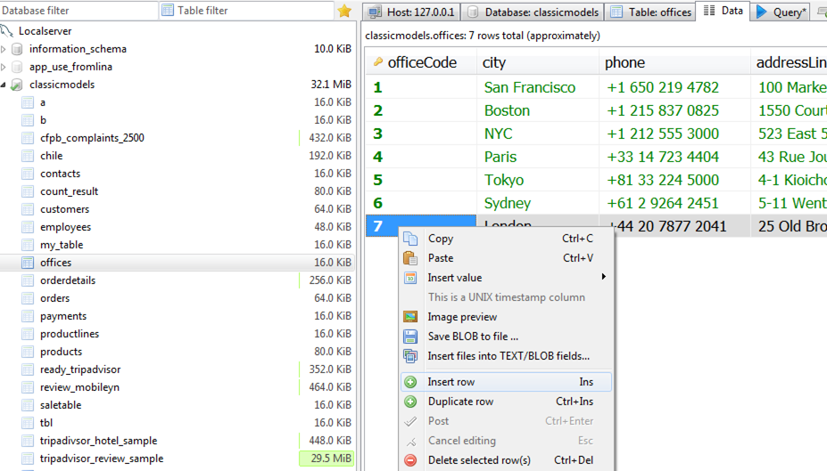
Insert by typing in HeidiSQL
Select “data” view
Right click on data
Select “insert row”

Slide 42
Numeric types: Floating-Point (Approximate Value)
Types | Storage | Negative value | Positive value
FLOAT | 4 | -3.402823466E+38～ -1.175494351E-38 | 0 and 1.175494351E-38～ 3.402823466E+38
DOUBLE | 8 | -1.7976931348623157E+308～ -2.2250738585072014E-308 | 0 and 2.2250738585072014E-308～ 1.7976931348623157E+308
Decimal requires more storage space, such as 9 bytes for Decimal(19,9).
https://www.mysqltutorial.org/mysql-decimal/
https://dev.mysql.com/doc/refman/8.0/en/storage-requirements.html
http://stackoverflow.com/questions/6949673/mysql-min-max-for-double-type
Notes:
https://dev.mysql.com/doc/refman/8.0/en/floating-point-types.html
https://www.mysqltutorial.org/mysql-decimal/

Slide 43

Comparing decimal and float
create table t1(c1 float(10,2), c3 decimal(10,2));
insert into t1 values(9876543.12, 9876543.12);
insert into t1 values(1234567.23, 1234567.23);

Slide 44
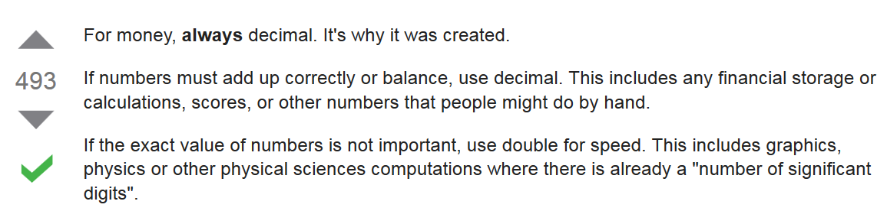
Difference between decimal, float and double
http://stackoverflow.com/questions/1165761/decimal-vs-double-which-one-should-i-use-and-when/1165788#1165788
When you need to compare values, use decimal!

Slide 45
MySQL INT(1) or INT(10)
An unsigned int has the max value of 4,294,967,295 no matter if its int (1) or int(10) and will use 4 bytes of data.
http://www.bajb.net/2008/10/mysql-int1-or-int10/

Slide 46
Date and Time Types
Year
Date ('YYYY-MM-DD')
Datetime ('YYYY-MM-DD HH:MM:SS')
Range: '1000-01-01 00:00:00' to '9999-12-31 23:59:59'.
Timestamp
Range: '1970-01-01 00:00:01' to '2038-01-19 03:14:07' UTC.
UTC: Coordinated Universal Time
It is very likely to reach its lower limit when TIMESTAMP is used -- e.g. storing birthdate.
Notes:
TIMESTAMP values are converted from the current time zone to UTC for storage, and converted back from UTC to the current time zone for retrieval. (This occurs only for the TIMESTAMP data type, and not for other types such as DATETIME.)

Slide 47
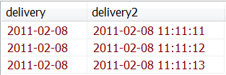
Bad format time and date?
CREATE TABLE `test`(delivery date, delivery2 datetime);
insert into `test` values (20110208, 20110208111111);
insert into `test` values ('2011-02-08', '2011-02-08 11:11:12');
insert into `test` values ('2011*02*08', '2011#02#08 11#11#13');

Slide 48


Current_time and now()
CREATE TABLE `test`(delivery datetime);
insert into `test` (delivery) values (now());
insert into `test` (delivery) values (current_time);
If you need only date or time
Curdate() for current date
Curtime() for current time
CREATE TABLE `test`(delivery date, delivery2 time);
insert into `test` values (curdate(), curtime());

Slide 49
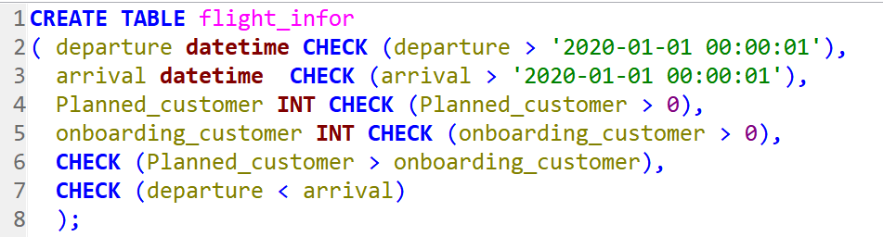
Using ‘Check’ to set Constraints
Notes:
CREATE TABLE flight_infor
( departure datetime CHECK (departure > '2020-01-01 00:00:01'),
arrival datetime CHECK (arrival > '2020-01-01 00:00:01'),
Planned_customer INT CHECK (Planned_customer > 0),
onboarding_customer INT CHECK (onboarding_customer > 0),
CHECK (Planned_customer > onboarding_customer),
CHECK (departure < arrival)
);

Slide 50
String Types
Char [range: 0 to 255]
Char(30) can hold up to 30 characters.
Varchar [range: 0 to 65,535]
Notes:
The CHAR and VARCHAR types are declared with a length that indicates the maximum number of characters you want to store.

Slide 51
Find bugs
create test (
testchar char(30); testvarchar varchar (30));
insert into test values ("This is a test","This is a test on varchar") ;
create table test (
testchar char(30), testvarchar varchar (30));
insert into test values ("This is a test","This is a test on varchar");

Slide 52
Question: What will happen by running these code?
CREATE TABLE `test`(story char(12));
insert into `test` (story) values ("MySQL is good");
/* SQL Error (1406): Data too long for column 'story' at row 1 */

Slide 53
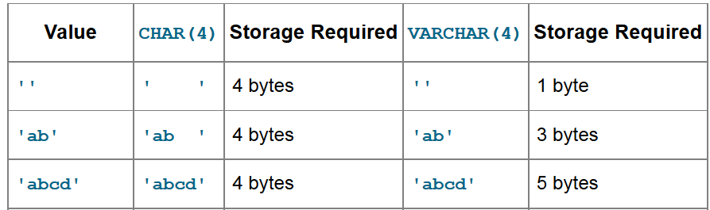
Compare Char and Varchar
‘Varchar’ could save space if the data in a column is variable in length

Slide 54
MySQL Spatial Data
http://www.percona.com/blog/2013/10/21/using-the-new-spatial-functions-in-mysql-5-6-for-geo-enabled-applications/

Slide 55
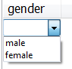
ENUM type
An ENUM is a string object with a value chosen from a list of permitted values that are enumerated explicitly in the column specification at table creation time.
CREATE TABLE stuff (gender ENUM('male', 'female'));

Slide 56

Spot the errors!
Assuming you are creating a table to store the information of about 200,000 employees for a company.
create table employee
(User_Num bigint,
Last_name varchar (50),
First name varcha(50),
Street varchar (100)
Payment float(10.2),
);
Errors:
‘First name’ should be ‘First_name’
varcha should be varchar
Missing comma in ‘Street varchar(15)’
Payment should better be in decimal type
Redundant comma ‘Payment float(10.2),’
Payment float(10.2), dot should be comma
User_Num bigint should be int.
Please use Presemo to provide your answer or VOTE answers at: presemo.aalto.fi/drm
http://freecredit3report.com/wp-content/uploads/2013/12/credit-report-error.jpg

Slide 57
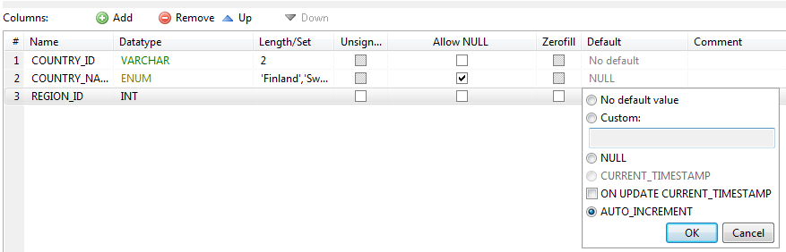
Set not null and auto_increment
If you set a variable to be “Auto_Increment”, you must define the variable to be the primary key as well.

Slide 58
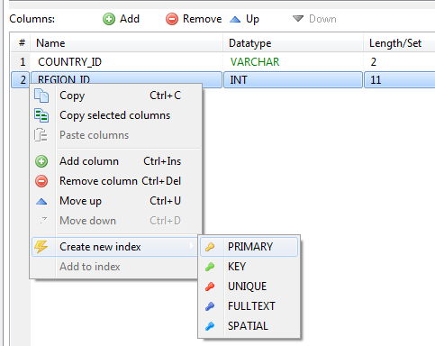
Set up primary key
Go to “basic” view →
Right click on the column that you want to set to be the primary key
→ ‘Create new index’ → ‘Primary’

Slide 59
Spot error
CREATE TABLE `countries` (
`COUNTRY_ID` int DEFAULT NULL Primary Key,
`REGION_ID` int(11) NOT NULL AUTO_INCREMENT )
/* SQL Error (1067): Invalid default value for 'COUNTRY_ID' */
/* SQL Error (1075): Incorrect table definition; there can be only one auto column and it must be defined as a key */

Slide 60

Challenge!
1. Please write a command to create a table named ‘product_order’, including columns of:
product ID;
product_name;
product_description;
order_ID;
Price;
delivery date.
presemo.aalto.fi/drm

Slide 61
Answer
create table product_order (
product_ID int(10),
product_name varchar(30),
product_description varchar(255),
order_ID int(10),
price decimal(10,2),
delivery_date date
);

